Slide 1
Integrating Behavioral Health Services in Primary Care:
A workshop on how to influence and change your part of the world for good.
Charmaine Dorsey LCSW
Los Angeles County-Department of Health Services
Christopher Benitez MD
Los Angeles County-Department of Health Services
David W. Hindman PhD
Los Angeles County Substance Abuse, Prevention & Control, Los Angeles County-Department of Public Health

Slide 2
Financial Disclosures
The presenters do not have any financial conflicts to disclose.

Slide 3

Warning!
This is a workshop.
You may have fun, but you will be asked to do stuff.
(You can’t integrate services by only talking to yourself)
If you are highly allergic to interacting with others, it is not too late to choose a different session.
We won’t be offended (much).

Slide 4
Objectives
At the end of this session, participants will be able to:
Describe the characteristics of an Integrated Behavioral Health Model
List opportunities within their settings to design an Integrated Behavioral Health Model and integrate behavioral health services.
Identify specific interventions to target the health disparities in your setting

Slide 5
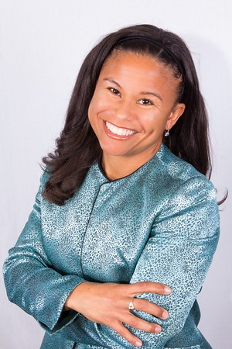
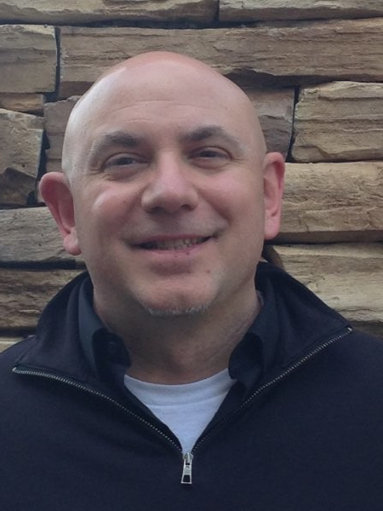
Getting to know your presenters
Charmaine Dorsey LCSW
Christopher Benitez MD
David Hindman PhD

Slide 6
Getting to know your neighbors
  Question 1: IN WHAT SETTING DO YOU WORK?
    Public sector/Public Clinic/Safety Net
    Private sector/Private Clinic
    Federally Qualified Health Center (FQHC)
    None of the above
Notes:
Need to insert the AUDIENCE RESONSE SYSTEM formatting.

Slide 7
Getting to know your neighbors
  Question 2: What is Your Professional Role?
    Primary care provider
    Mental Health Provider
    Substance Abuse Provider
    None of the above

Slide 8
Getting to know your neighbors
  Question 3: How many times in the past 30-days have you worked with someone in a different role/field of health care?
    0
    1-5
    6-10
    11-20
    20+

Slide 9
Getting to know your neighbors
What are you hoping to get out of being here?
What does integration mean to you?
How does integration of services happen in your setting?

Slide 10
SAMHSA Models of
Integrating Behavioral Health Services for Adults

Slide 11
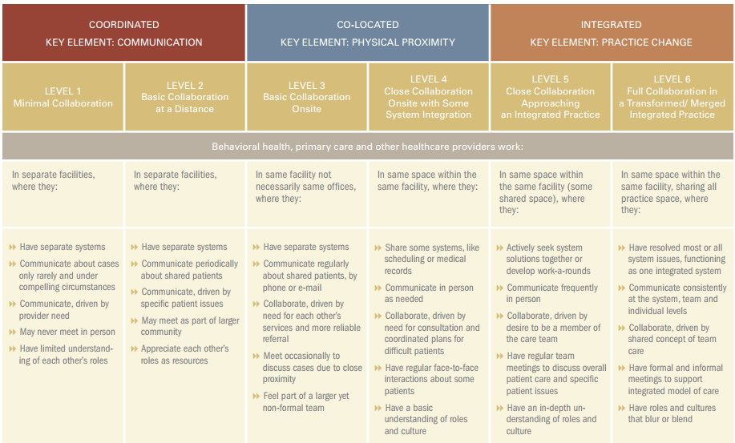
From Separation to Integration of Services

Slide 12
Integration of Behavioral Services in the
LA County Health Agency:
Current State

Slide 13

http://healthagency.lacounty.gov/

Slide 14



Directly operates:
- 4 hospitals/med centers
1 large regional health center,
1 large outpatient center,
7 comprehensive health centers,
multiple health centers.
Serves ~350K patients empaneled in Primary Care Medical Homes (PCMH)
Largest public mental health system in the country
Primarily operates and/or contracts for outpatient specialty MH services.
Serves over 250,000 clients annually
Broad Public Health mission
Responsible for building/main-taining/managing specialty substance abuse services for MediCAL recipients in LA County.
Notes:
PROBLEM STATEMENT
While LA County has significant behavioral health (BH) resources in its public safety net system, these services are:
fragmented & difficult for primary care patients to access;
Often have administrative/programmatic limitations on who, what and where services can be given;
have inconsistent scope of practice, productivity expectations & metrics of performance.
This CHIP involved:
Creation of a model and implementation plan for integrating BH providers into LA County’s public safety net primarily care medical homes;
Leveraging the unique opportunities present in the LA County Health Agency.

Slide 15




Health Plan Behavioral Health Options
Beacon: 877-344-2858
BHN: 800-541-3353
Health Plans are responsible for providing mental health services for MediCAL recipients for “mild to moderate” mental health conditions.

Slide 17
Integration of Behavioral Services in the
LA County Health Agency:
What is the problem unintegrated Services?

Slide 18
The Pain/Problem Integrated Behavioral Health Services Addresses
Notes:
The majority of primary care encounters (~70%) involve some sort of behavioral health concern.
There is limited capacity to immediately address behavioral health concerns (e.g. Mental Health, Substance Use Disorders, or Emotional/Behavioral Factors Affecting Med Conditions) currently in LA County DHS clinics.
Available Behavioral Health Resources tend to be:
Generally located outside DHS (e.g. DMH, Carve-out benefit, etc)
Focused/limited in scope to a single or few types of BH concerns
Not immediately available, requiring referral (only ~30% of which result in visits)
Difficult/confusing referral pathways for BH services.
Most BH Providers do not provide feedback to, nor specific collaboration with, PCMH.
* Internal Behavioral Health capacity across LA County-DHS is:
markedly varied by site.
not consist in scope nor operating processes
Not currently nor consistently monitored/evaluated for productivity, quality, etc.

Slide 19
Usual Referral Process-LA County Department of Health Services
Primary Care Provider (PCP) Identifies a Concern requiring a specialist
PCP creates an eConsult to Specialists. Can dialogue about concern/management plan. Specialty can evaluate pt F2F is needed.
Specialist evaluates patient if a face to face is needed. Evaluation available to PCP in Electronic Med Record.

Slide 20
Current Behavioral Health Referral Pathways in LAC DHS
Refer to 800-No-BUTTS
Refer to DMH
Encourage pt to go to Psych Urgent Care
Encourage or assist pt to call the LA County Substance Abuse Service Helpline (SASH)
Encourage pt to go to the Psych ED
PCP identifies a BH Concern
Encourage pt to call INS company for carve out BH benefits
Call Psych Mobile Response Team/LAPD to Eval/Write a Hold
Contact on site BH provider (if available)

Slide 21
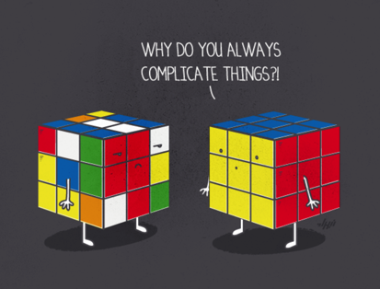
(Behavioral Health)
(Primary Care)
20

Slide 22
Integration of Services in the LA County Health Agency:
Barriers/Challenges
  Health Information Exchange (HIE): Roles
  Health Information Exchange (HIE): Tech/Logistics
  Siloed Systems of Care: Physical Health vs. Mental Health vs. Substance Use providers are:
    Located in different clinics
    Use different computer systems
    Limited in the types of services they can provide by funding stream.
Solutions
  Bring IBH to primary care where the majority of the patients come.
  Proposal will increase access to Services, but integrated behavioral health (IBH) conditional to Release of Information for HIE.
  Use new SUD funding stream to fund positions to provide broad range BH Services
Notes:
Charmaine to expand this slide

Slide 23
Integration of Behavioral Services in the
LA County Health Agency:
Future State

Slide 24
Operationalization of Integrated Behavioral Health Services
eConsult to DMH
PCMH Team identifies a BH Concern
Referral to to Psych Urgent Care
Go to the Psych ED
PCP Identifies a Behavioral Health Concern
Contacts on-site DHS BH Provider for immediate evaluation, treatment or consultation. Uses other resources only if needed.
Link to Payor based carve out BH benefits
Admit to Higher level SUD Services
Call 800-No-BUTTS
Call Psych Mobile Response Team/LAPD to Eval/Write a Hold
Services Provided within Primary Care Medical Homes
BH Managed Referrals Outside PCMH
ESTABLISH & MONITOR METRICS OF PERFORMANCE

Slide 25
Convergence: Aligning Agency Resources to Maximize Patient Access & Impact
Notes:
PROBLEM STATEMENT
While LA County has significant behavioral health (BH) resources in its public safety net system, these services are:
fragmented & difficult for primary care patients to access;
Often have administrative/programmatic limitations on who, what and where services can be given;
have inconsistent scope of practice, productivity expectations & metrics of performance.
This CHIP involved:
Creation of a model and implementation plan for integrating BH providers into LA County’s public safety net primarily care medical homes;
Leveraging the unique opportunities present in the LA County Health Agency.

Slide 26
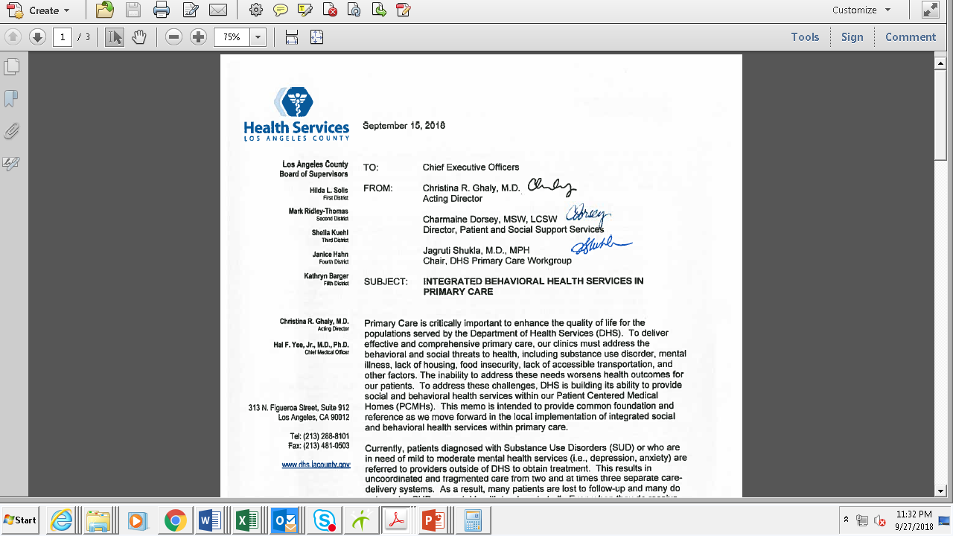
Notes:
Leadership Lessons learned:
Accomplishments of greatest significance rarely can be accomplished alone.
Significant effort needs to be invested to align innovations with leadership’s organizational priorities in order to ensure necessary organizational buy-in.
Stay committed, wherever you are.
Seize resource opportunity when they present.
“It is amazing what you can accomplish if you do not care who gets the credit” –Harry Truman

Slide 27
Workshop:
Time to Develop your own Integration Solutions
Notes:
Charmaine to outline the activity. Will submit the proposals
We need a worksheet to provide necessary framework for participants

Slide 28
Workshop: Time to Develop your own Integration Solutions
What do you want to do?
Activities:
  Principles/Goal
  Opportunities/Roles
  Barriers/Challenges
  Model/Solutions
    Identify and outline steps needed to implement
      E.g. projection; budget request; hiring; policy
    ID elements of design/intent to address challenges
Notes:
David to take a stab at this on weekend of 9/21.
We need a worksheet for
Will send to team on Monday, 9/23

Slide 29

Step 1: Form a workgroup of 3-5 people.
You don’t have to look far.
Introduce yourself to 2-4 people around you and……..
        NOW you have a workgroup!

Slide 30
Step 2: What do you want to do?
Try to clearly define the problem that you are wanting to address.
Why is this a problem? What is problematic about it?
What would ‘better’ look like?
What are you wanting your solution to help improve

Slide 31
Step 3: What are the principles you want to establish in approaching your problem?
What are the principles that you want to use to guide the development of your solution?
Try to limit these to no more than 3 principles.
Example: For our Integrated Behavioral Health project, some of our principles were:
  Services needed to be provided where the majority of the patients are.
  Integrated Behavioral health providers should be able to address a range of behavioral health conditions.
  Services should be revenue generating vs. draining.

Slide 32
Step 4: What are the opportunities that you want to seize? Who are the persons/roles that the need to be considered and included?
What challenges/opportunities currently exist in your organization that can support your effort?
How can you align what you are trying to do with your organization’s priorities/needs?
Who are the critical players to involve in your effort?

Slide 33
Step 5: What are the Barriers and Challenges that you expect to face or must overcome?
What barriers or challenges to your efforts are you anticipating? (Note: They could be situations or persons)
Who is critical to have buy in from for your project to move forward and be successful?

Slide 34
Step 6: Make Models for potential solutions to the problem that you want to address.
Identify and outline steps needed to implement your solution
  E.g. projection; budget request; hiring; policy
Identify elements of design that are intended to address challenges.

Slide 35
It’s GO TIME!
Work with your group to develop an innovative solution for integrating services.
You will have____ mins to work on this.

Slide 36
Report Out
Select of Spokesperson & Walk us through your process:
  What did you decide you wanted to do?
  What were your:
    Principles/Goals
    Opportunities/Roles
    Barriers/Challenges
    Models/Solutions
      What are the steps needed to implement?
        E.g. projection; budget request; hiring; policy
      What were the elements of design/intent to address challenges?

Slide 37

Leadership Lessons: The making of a movement….
Notes:
This is leadership from a dancing guy Sasquatch music Festival 2009.
Official transcript at http://sivers.org/ff (Narration) https://youtu.be/hO8MwBZl-Vc
Or https://youtu.be/GA8z7f7a2Pk (no narration, with the music)

Slide 38
Wrap-up
Charmaine to draft…..

